Slide 1
Music taken out of context
an idea by Phillip, Casey, Stephen, and Santiago

Slide 2
Inspiration

Slide 3
Inspiration
Desire for new relationships

Slide 4
Inspiration
Desire for new relationships
Dread for awkward moments

Slide 5
Inspiration
Desire for new relationships
Dread for awkward moments
Uncomfortable with randos

Slide 6
Ran•do [ran- doh], n. 1. a person you haven’t met yet. 2. a person with whom you haven’t found anything in common with.

Slide 7
Potential friend
Rando

Slide 8
MUSIC

Slide 9
MUSIC
Passionate

Slide 10
MUSIC
Passionate
Fun to talk about

Slide 11
MUSIC
Passionate
Fun to talk about
Something to bond over

Slide 12
music
to Connect people

Slide 13
Interviews

Slide 14
Interviews
Conversations
Cycle through topics until you find a common interest
Comfortable with people with similar experiences
First 2 min make it or break it
Music
Choose music based on their situation
Use music tastes to infer about someone’s personality
Hesitant to share music

Slide 15
Task Analysis

Slide 16
Task Analysis
Users:
students in a social atmosphere, looking to make friends
Desires:
eliminate rando factor
selected sharing of music tastes
Disconnect:
people don’t really know what others are listening to
share music on extreme occasions (really good new song)
Notes:
private or broadcasted(published)

Slide 17
Brain Storm

Slide 18
Contextual Music suggestions

Slide 19
Contextual Music suggestions
Contextual playlists
Notes:
recognize your friends are in a car, suggest music for road trip
create a playlist based on all of your preferences
recognize your music listening patterns and creates a playlist

Slide 20
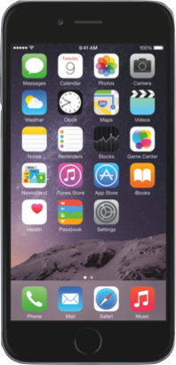
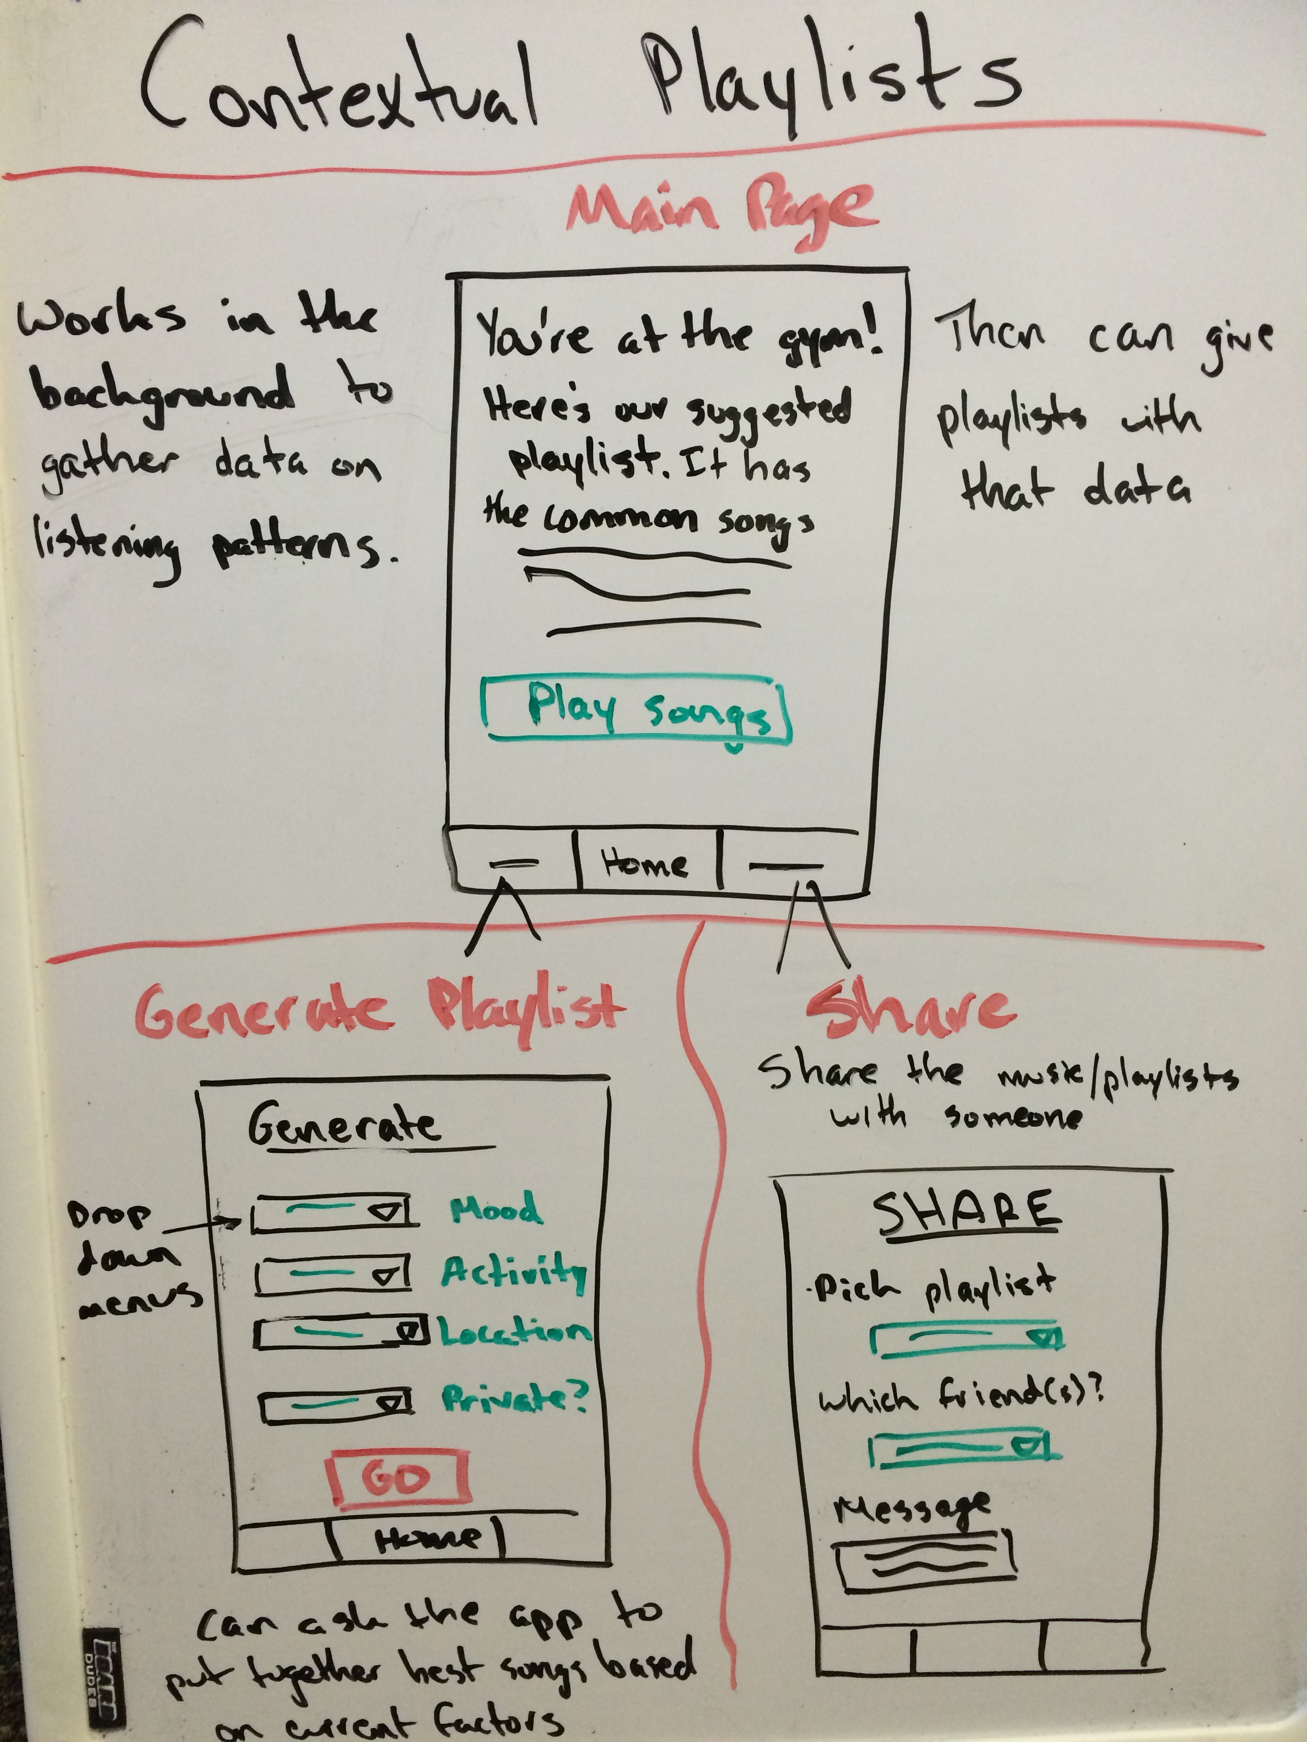
Prototypes
Automated playlists based on habitual actions

Slide 21
Prototypes
Car playlists generated with everyone in mind

Slide 22
Contextual Music suggestions
Contextual playlists
Notes:
recognize your friends are in a car, suggest music for road trip
create a playlist based on all of your preferences
recognize your music listening patterns and creates a playlist

Slide 23
Contextual Music suggestions
Contextual playlists
Contextual song recommendations
Notes:
suggest a song to play at a party based on people in proximity
predict whether or not a song you choose will be popular
whats been played at this location before
why its different:
utilize more data than just individual previous song choices
automate process that users already do
recognizes that music is dependent on environmental factors
music is social and friends matter

Slide 24
Prototypes
Predicts song popularity based on people nearby

Slide 25
Contextual Music suggestions
Contextual playlists
Contextual song recommendations
Notes:
suggest a song to play at a party based on people in proximity
predict whether or not a song you choose will be popular
whats been played at this location before
why its different:
utilize more data than just individual previous song choices
automate process that users already do
recognizes that music is dependent on environmental factors
music is social and friends matter

Slide 26
Contextual Music suggestions
Contextual playlists
Contextual song recommendations
Musical relationships
Notes:
show the face of the person you are most likely to get along with
search facebook friends by music taste
plays a random song, if you like - shows whose been listening to it

Slide 27
Contextual Music suggestions
Contextual playlists
Contextual song recommendations
Musical relationships
Musical introductions
Notes:
lightup if similar music tastes during handshake
playing a song you guys both likes
create a quick get to know me
explain reasoning behind suggestions
provide talking points
bring music into conversation
why its different:
facilitate the process of bonding through music
remove hesitation by ensuring music commonalities
groups friends through music

Slide 28
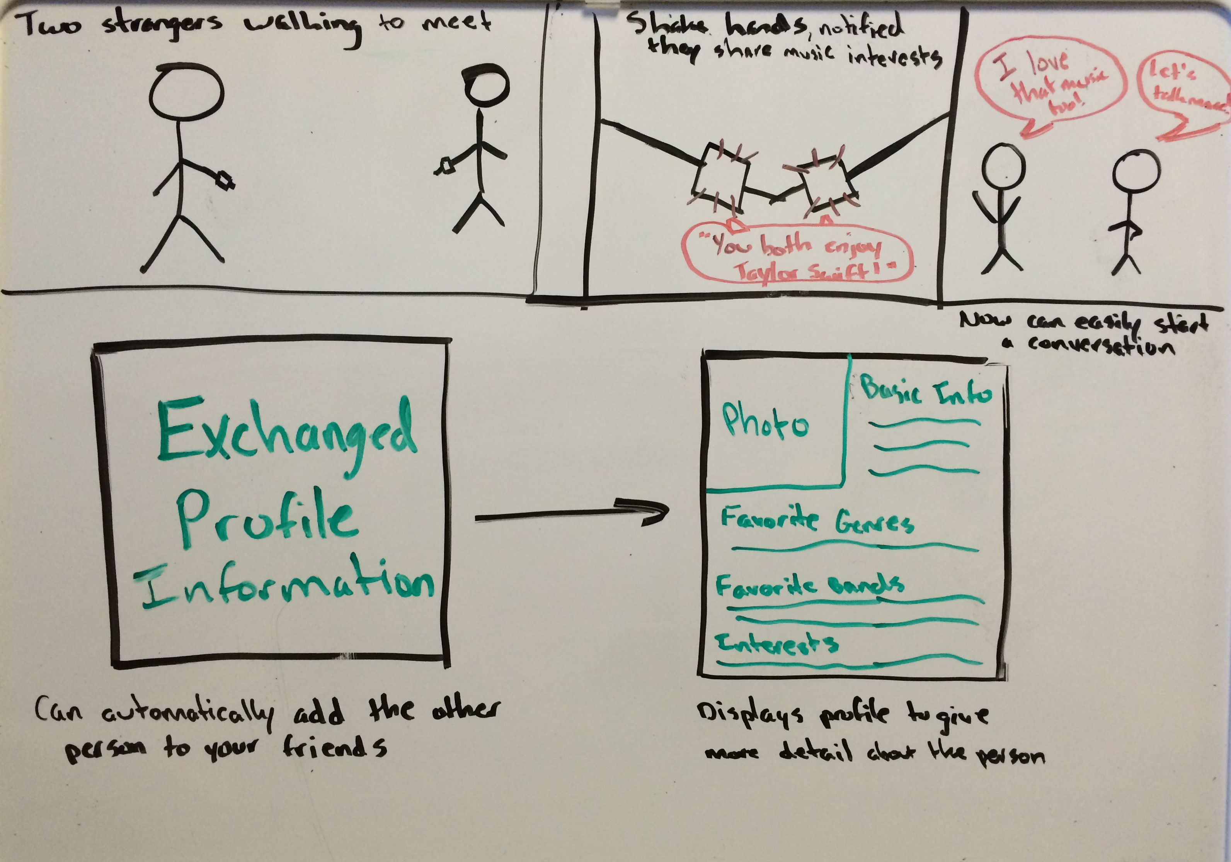
Prototypes
Using music to facilitate introductions

Slide 29
Questions

